Slide 1
Ch. 14
VISUAL PERSUASION

Slide 2
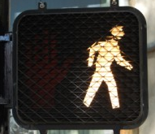
How Images Persuade
Iconicity
Instant Recognition
Often Resemblance

Slide 3
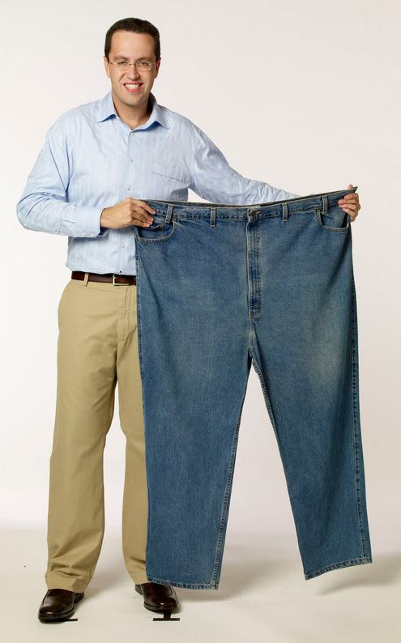
How Images Persuade
Indexicality
Documents Events
Uses “Sign Reasoning”
CLICK

Slide 4
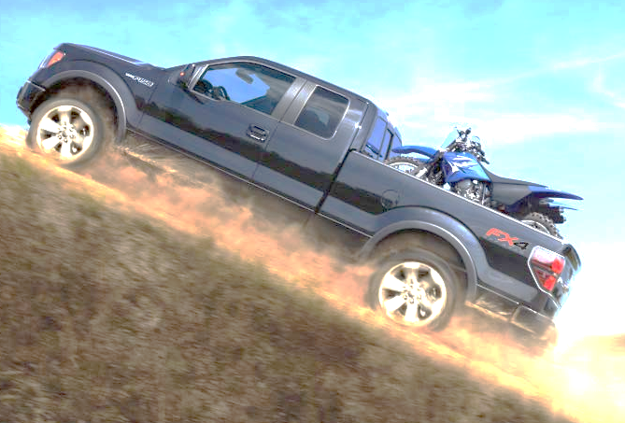
How Images Persuade
Syntactic Indeterminacy
Indirect Relationships
Gilt/Guilt by Association
HOWEVER, not always controllable to creator

Slide 5
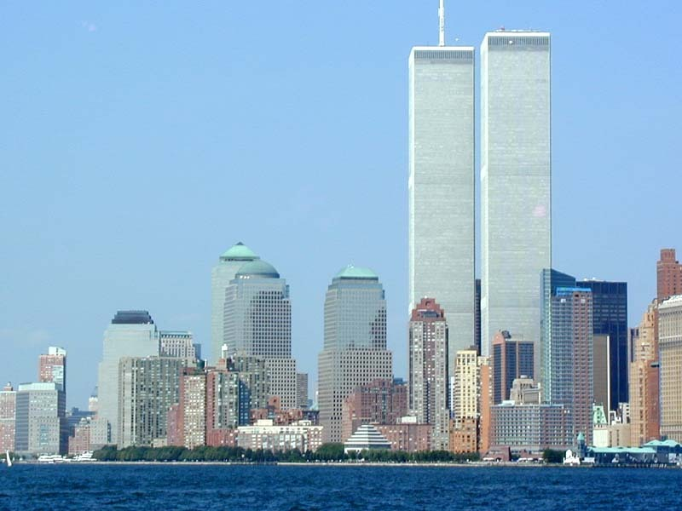
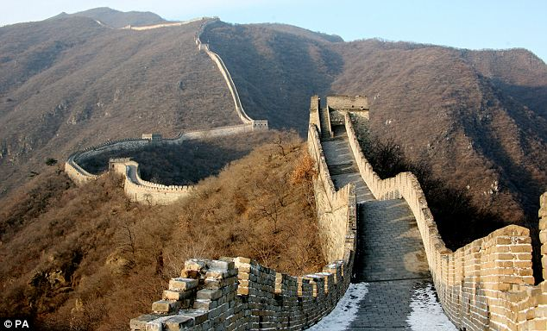
Contexts
Architecture
Designs are intentional
To Influence Mood, Perception, & Behavior
Buildings, monuments, hospitals, casinos, prisons

Slide 6
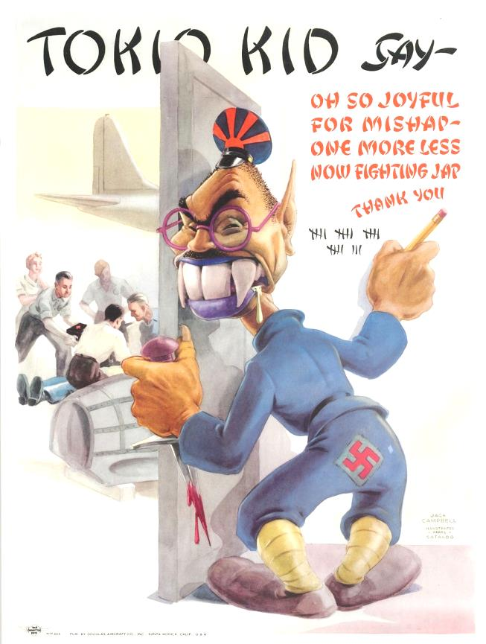
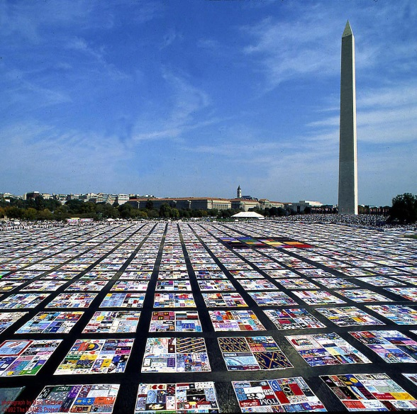
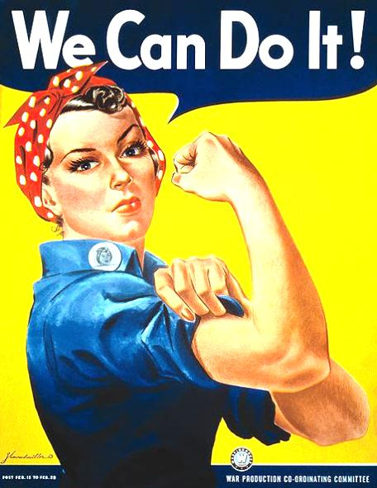
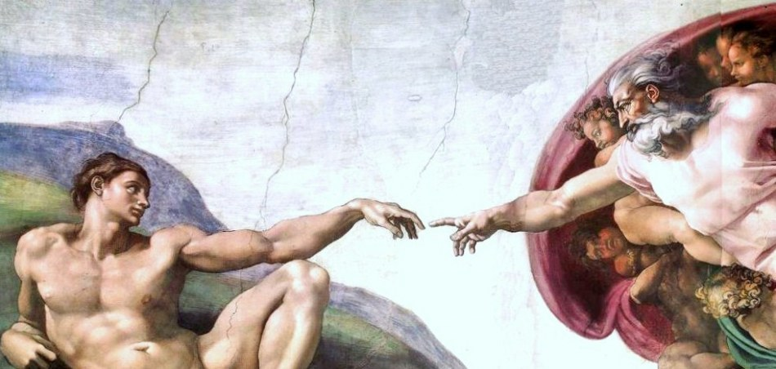
Contexts
Art
To Celebrate, Protest, Recruit, etc.

Slide 7
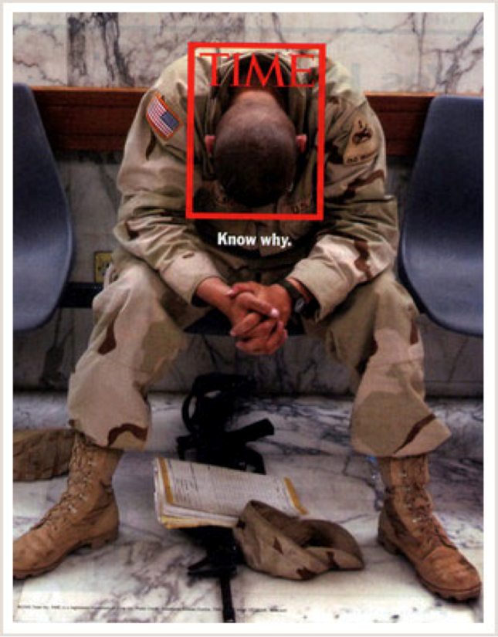
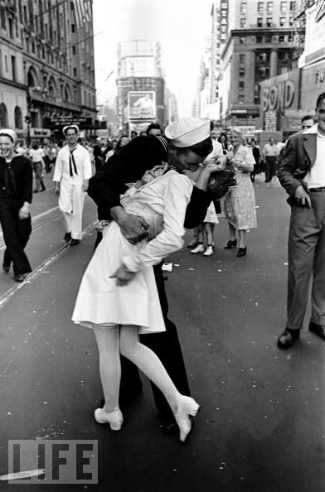
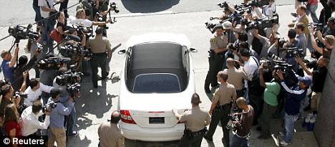
Contexts
Photo Journalism
“1000 Words”
One View

Slide 8
Contexts
Cinema
Mass Influence Potential
Uses Narrative Form
Audience more Vulnerable

Slide 9
Contexts
Cinema
How Movies Persuade
Biggest US Export
Pop Culture
Modeling
Idolizing
Fostering/Perpetuating Stereotypes

Slide 10
Contexts
Images in Advertising
Visual Extravaganzas
Vivid, intense, over the top visuals
i.e. Camry, Herding Cats Commercial https://youtu.be/m_MaJDK3VNE

Slide 11
Contexts
Images in Advertising
Anti - Ads
Ads that mock ad techniques
i.e. Carls Jr Ads, Axe, the title slide of this ppt
https://youtu.be/vgxxAwue7Fs

Slide 12
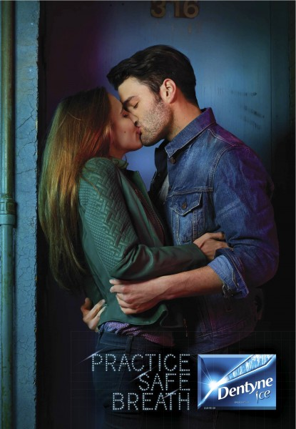
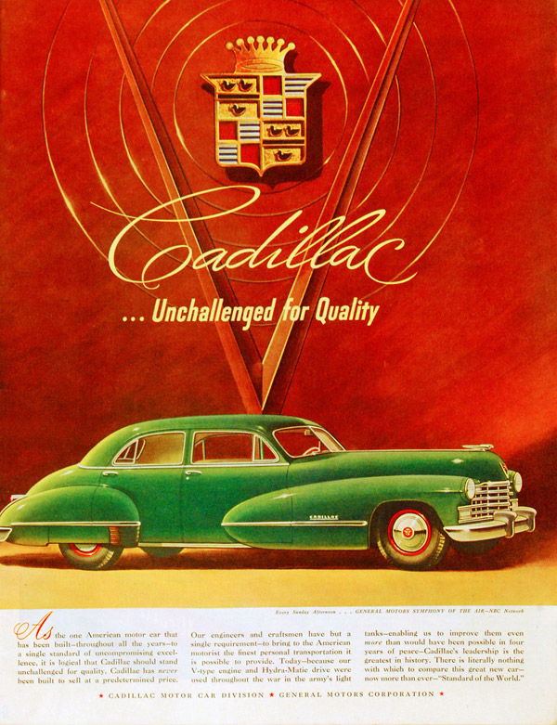
Contexts
Images in Advertising
“Branding” (Image-Oriented Ads)
Social Status / Elitism
Sex / Romance

Slide 13
Contexts
Images in Advertising
“Branding” (Image-Oriented Ads)
Power, Strength, Specialness https://youtu.be/NO1Ly6zAe48

Slide 14
Contexts
Images in Advertising
“Branding” (Image-Oriented Ads)
Power, Strength, Specialness
Youth Culture

Slide 15
Contexts
Images in Advertising
“Branding” (Image-Oriented Ads)
Safety, Security
Sense of Belonging, Home
https://youtu.be/2ON-gw2j1tE

Slide 16
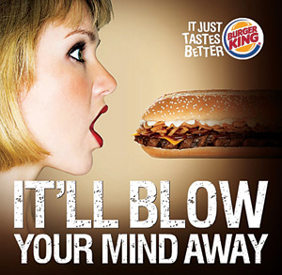
Contexts
Images in Advertising
Shock Ads
Push Limits of Appropriateness
“No press is bad press”
Walk fine line to work

