Slide 1
Outline Bootcamp

Slide 2
Why Outline
Reduces Nervousness
Keeps You on Track
Easier for Audiences to Follow

Slide 3
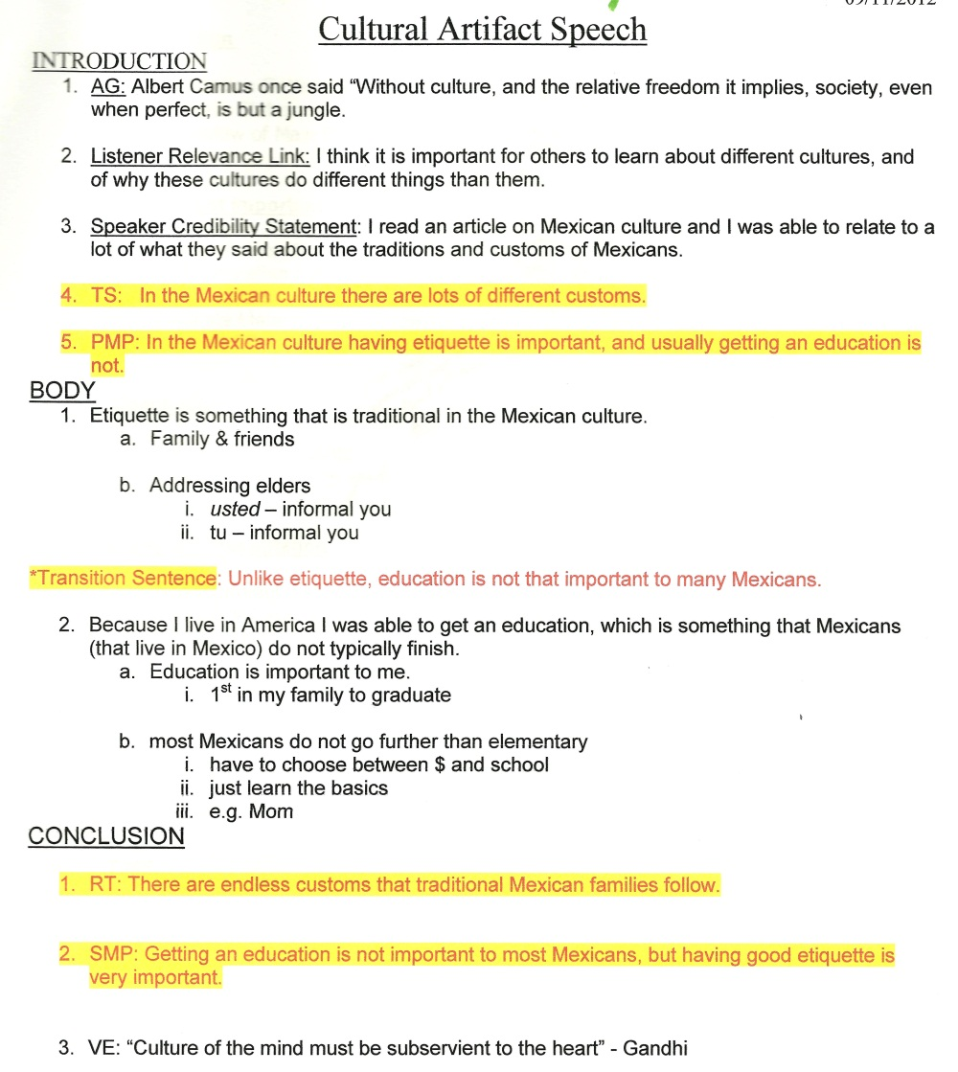
Principles of Outlining
Keep it Concise
Use Subordination
Use Clear Fonts
Use Indenting, Boldface, Color

Slide 4
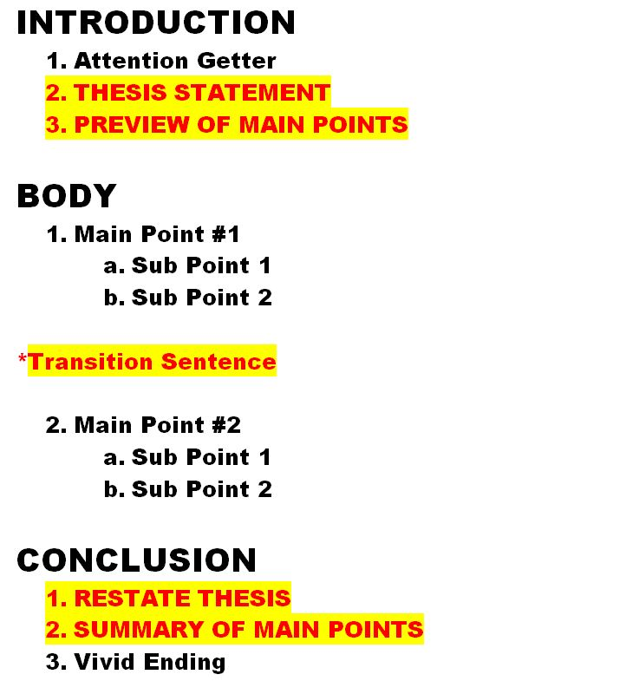
Parts of the Outline
Intro
Attention Getter
Thesis
Preview of Main Points
Body
Main Points
2 Subpoints (or more)
Transitions
Conclusion
Restate Thesis
Review of Main Points
Vivid Ending

